Slide 1
Lesson 3
Program for change
Abstract class
Polymorphism
Interfaces
Open-closed principle
Liskov Substitution Principle

Slide 2
Abstract class
When a class has at least one abstract method , it is an abstract class.
A method declared abstract is not actually implemented in the current class. It exists only to be overridden in subclasses. It has no body.
An abstract class cannot be instantiated
Each subclass of an abstract class must override the abstract methods of its superclass or itself be declared abstract.

Slide 3
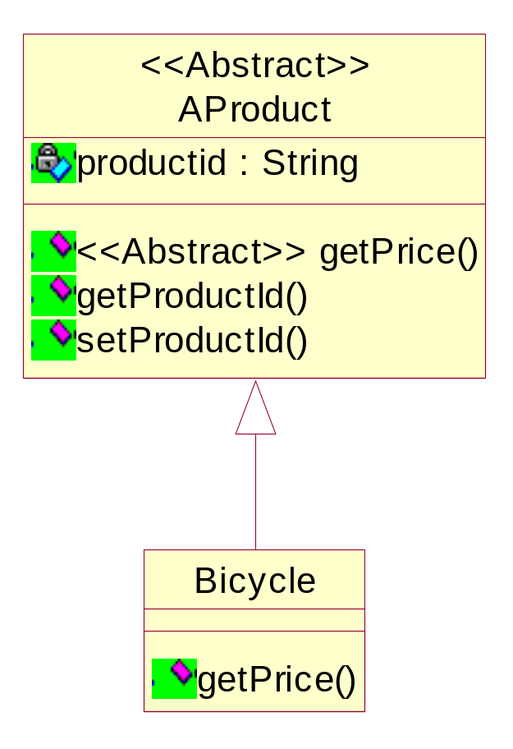
Abstract class Example
public abstract class AProduct
{
private String productid;
public void setProductId (String id){
productid=id;
}
public String getProductId (){
return productid;
}
public abstract double getPrice() ;
public class Bicycle extends AProduct
{
public double getPrice(){
return 230.45;
}
}
Not possible
AProduct mybycicle = new AProduct()
AProduct mybycicle = new Bicycle()

Slide 4
When do we use an abstract class?
Explain the answer. Use a picture.
Polymorphism
Polymorphism = many forms
Objects of a particular type can take many different forms
Implemented with dynamic binding (late binding)

Slide 5
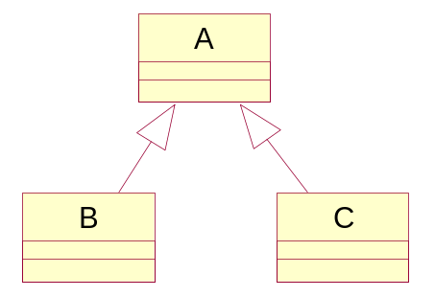
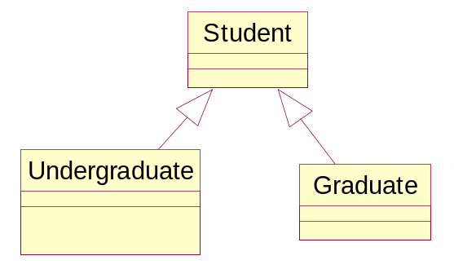
Dynamic binding
An object of type A, can be bound to an object of type B or C
class Student {…}
class Undergraduate extends Student {…}
class Graduate extends Student {…}
Student st1,st2, st3;
Graduate st4;
st1 = new Student(); // okay
st2 = new Undergraduate(); // okay
st3 = new Graduate(); // okay
st2 = new Graduate(); // okay
st4 = new Student(); // compilation error

Slide 6
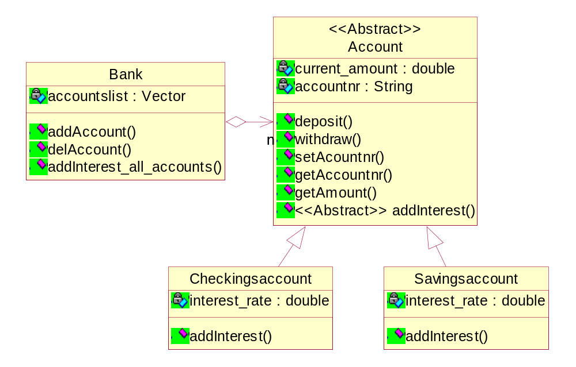
Polymorphism example

Slide 7
public abstract class Account{
private long current_amount;
protected double interest_rate;
private String accountnr;
public void deposit(long amount){
current_amount+=amount;
}
public void withdraw(long amount){
current_amount-=amount;
}
public void setAccountnr(String anr){
accountnr=anr;
}
public String getAccountnr(){
return accountnr;
}
public double getAmount(){
return current_amount;
}
public abstract void addInterest();
}
public class Checkingsaccount
extends Account {
public void addInterest(){
deposit(getAmount()*interest_rate/2);
}
}
public class Savingsaccount
extends Account {
public void addInterest(){
deposit(getAmount()*interest_rate);
}
}
// Note that the actual interest rate
// for a checking account might be
// 0.01 and for a savings it could
// be 0.02 (two percent)

Slide 8
public class Bank{
private ArrayList accountslist;
public void addInterest_all_accounts(){
Account account;
for (int x=0; x<accountslist.size(); x++){
account=(Account)accountslist.get(x);
account.addInterest(); // POLYMORPHISM HERE!!
}
}
public void addAccount(String type, String accountnr){
Account account;
if (type.equals("checking")){
account = new checkingsaccount();
account.setAccountnr(accountnr);
accountslist.add(account);
}
}

Slide 9
public void delAccount(String accountnr){
Account account;
for (int x=0; x<accountslist.size(); x++){
account=(Account)accountslist.get(x);
if (account.getAccountnr().equals(accountnr)){
accountslist.remove(x);
break;
}
}
}
}

Slide 10
public class application{
static public void main(String args[]){
Bank mybank = new Bank();
mybank.addAccount("checking", "1");
mybank.addAccount("checking", "2");
mybank.addAccount("savings", "3");
mybank.addInterest_all_accounts();
}
}

Slide 11
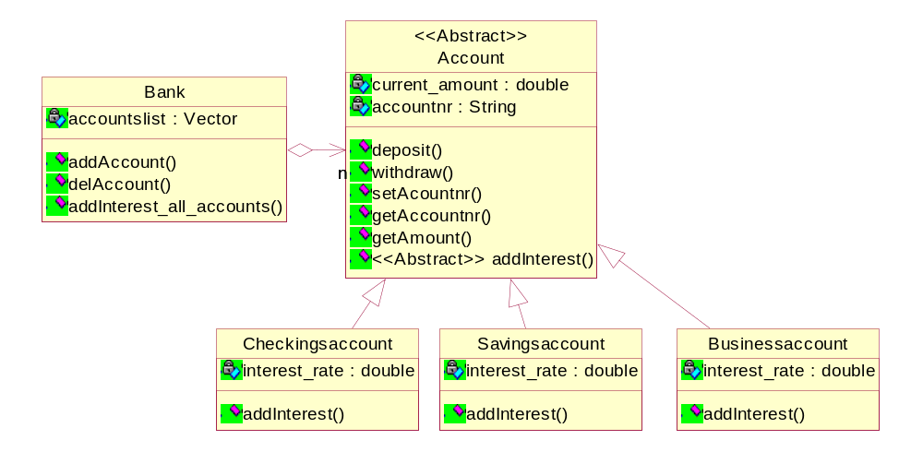
Why do we want polymorphism?
It allows us to extend our program with new features without changing existing (already tested)code.

Slide 12
    Open-Closed principle
Software design should be open for extension, but closed for modification.
All systems change during their life cycle, but when a single change results in a cascade of changes, the program becomes fragile and unpredictable. When requirements change, you implement these changes by adding new code, not by changing old code that already works.
See bank example: new accounts (credit card account, business account) can be added without changing the other classes.
Software modules can never be 100% closed for modification. Programmer has to decide what aspects should be closed.

Slide 13
Open-closed principle is realized through the strategy pattern
If you have an object that uses different algorithms to compute the same variable, then:
Different algorithms may be applicable at different times.
The same algorithm may be applicable in different objects.
The algorithm may use data that the object doesn't need to know about.
public class Account{
private double checkings_interest= 0.023;
private double savings_interest= 0.0415;
public void addInterest(){
if (type.equals("Checkings")){
current_amount = current_amount* checkings_interest;
}
else {
current_amount = current_amount* savings_interest;
}
}
}
Can not be extended
Can not be reused

Slide 14
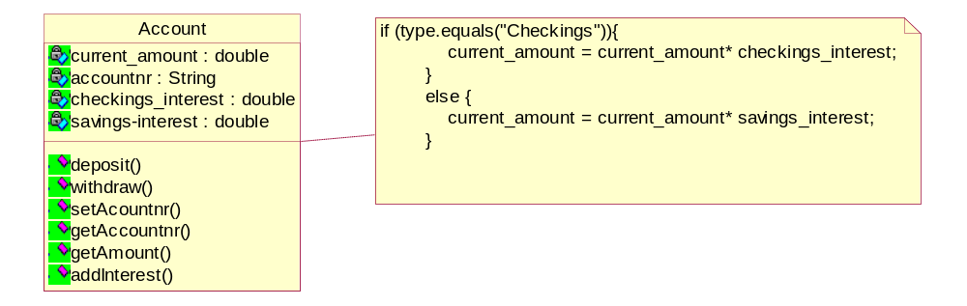
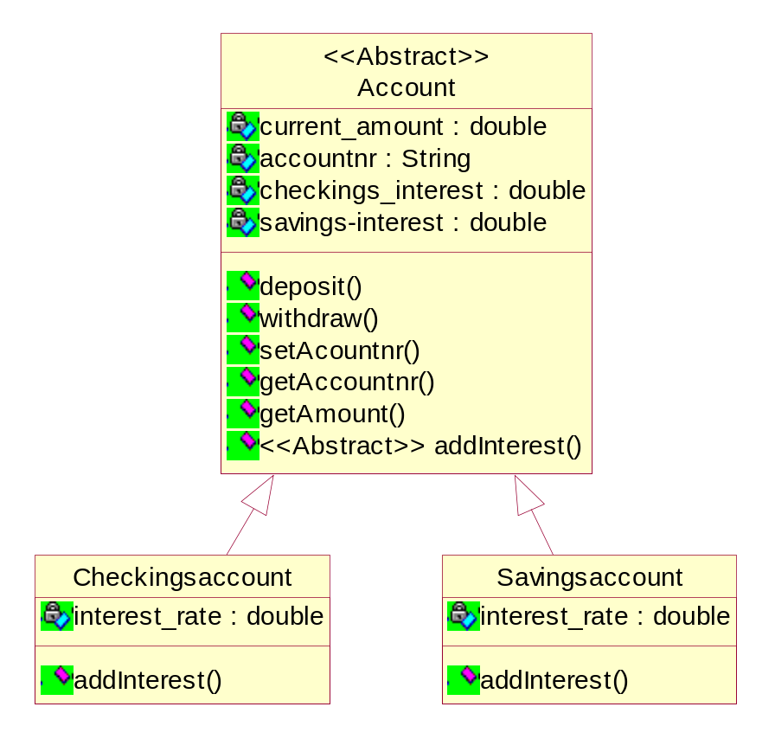
Encapsulate the different algorithms by defining objects for them (strategy objects). Objects which use the algorithm hold a reference to the strategy object. Switch algorithms by switching strategy objects.

Slide 15
General technique:
    Abstract out the changing from the unchanging
    Put the unchanging in an abstract base class
    Encapsulate the changing aspect and place it in the subclass
Unchanging
+
Changing
unchanging
Changing 1
Changing 2

Slide 16
Interfaces
Allow us to separate interface from implementation.
Why Interfaces?
1. Interfaces enable us to implement multiple inheritance in Java.
2. Interfaces support flexibility (change).
3. Interfaces support team development.

Slide 17
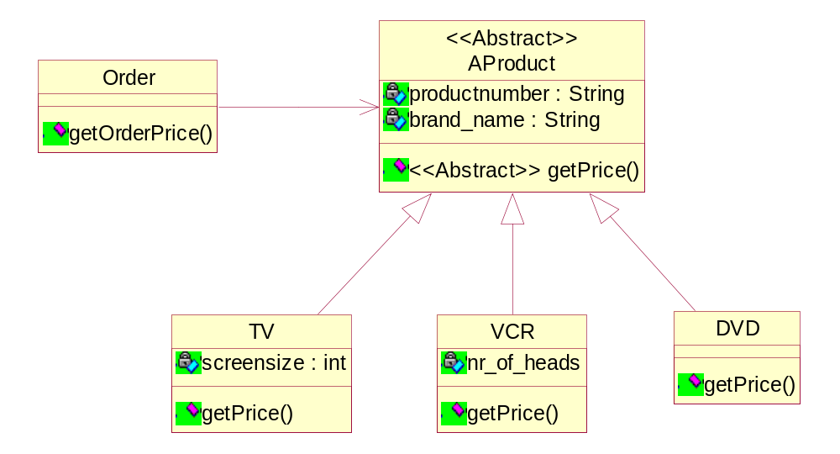
Interfaces support flexibility.
Interfaces lets you take greater advantage of polymorphism in your designs, which in turn helps you make your software more flexible.
What if I also want to offer services to customers?

Slide 18
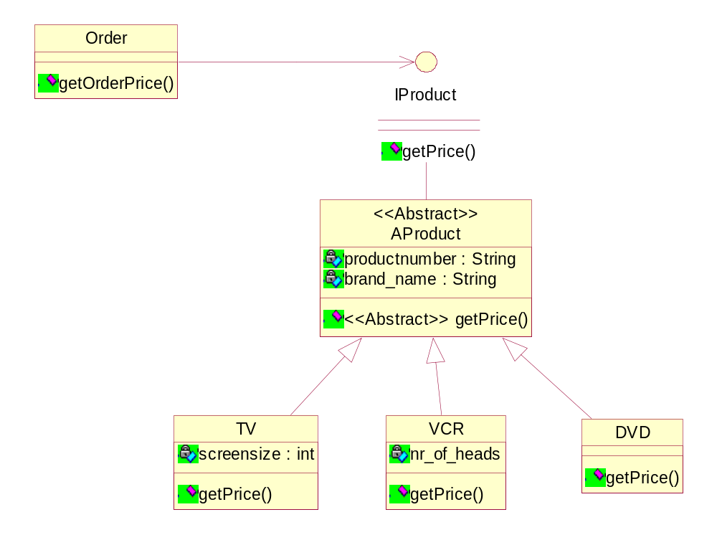
If I use interfaces I can easily add a new class hierarchy

Slide 19
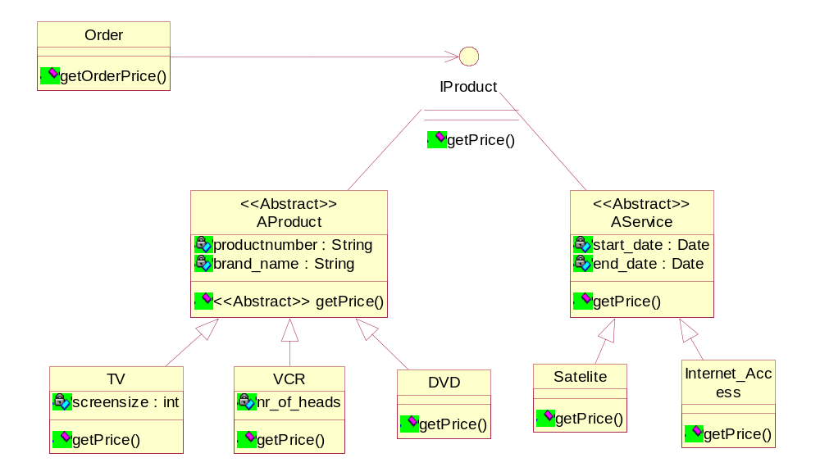

Slide 20
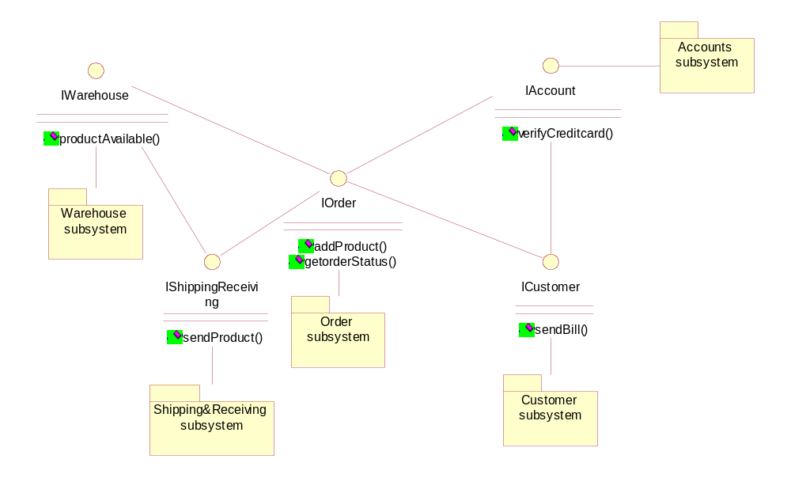
Interfaces support team development.
First define the interfaces for all subsystems, then every programmer can program one subsystem by using the interfaces of the other subsystems.
The implementation of subsystems may change without effecting all other subsystems, as long as the interfaces remain the same.

Slide 21
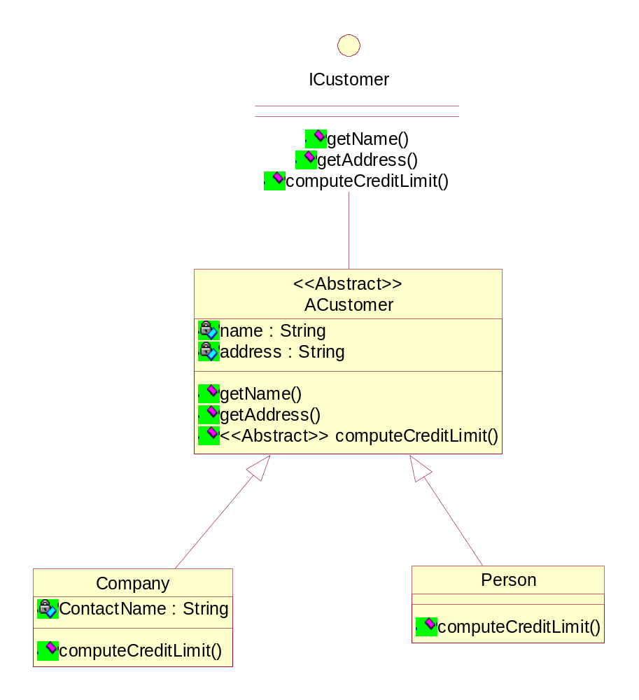
Interface vs. abstract class
Interface has no data, except constants
Interface takes abstraction one step further.
Abstract class is an abstraction of its subclasses.
Interface is most abstract.
Abstract class can have some concrete methods, and data members.

Slide 22
When do we use interfaces?
If you have a subsystem that represents an abstraction that may have multiple implementations, whether the subsystem is a single object, a group of objects, an entire Java applet or application, you should define Java interfaces through which the rest of the world communicates with that subsystem.
When you use interfaces in this way, you decouple the parts of your system from each other and generate code that is more flexible: more easily changed, extended, and customized.
Program to interface, rather than implementation.

Slide 23
Program to interface, rather than implementation.
public interface ICustomer
{
public String getName();
public String getAddress();
public double computeCreditLimit();
}
public abstract class ACustomer
implements ICustomer
{
private String name;
private String address;
public ACustomer(String name, String address) {
this.name=name;
this.address=address;
}
public String getName() {
return name;
}
public String getAddress() {
return address;
}
public abstract double computeCreditLimit()
}
public class Person extends ACustomer
{
public void computeCreditLimit() {
// compute credit limit of a person
}
}
public class Company extends ACustomer
{
public void computeCreditLimit() {
// compute credit limit of a Company
}
}
//Person newcustomer = new Person(“Frank Moore”, “23 Main Fairfield IA 52556”);
ICustomer newcustomer = new Person(“Frank Moore”, “23 Main Fairfield IA 52556”);

Slide 24
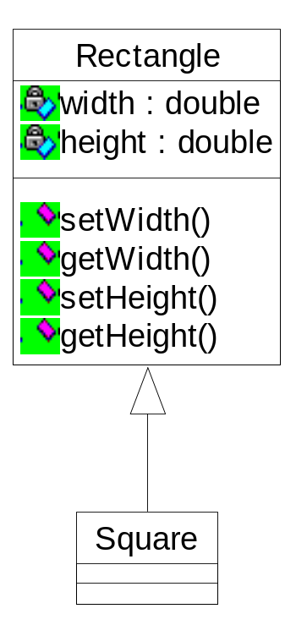
Liskov Substitution Principle
users of a base class should be able to use derived classes without knowing it.
public class Rectangle{
private double width;
private double height;
public void setWidth(double w){
width=w;
}
public double getWidth(){
return width;
}
public void setHeight(double h){
height=h;
}
public double getHeight(){
return height;
}
}
public class Square extends Rectangle{
}
public class application{
public void foo(Rectangle rec){
rec.setWidth(5);
rec.setHeight(2);
}
static public void main(String args[]){
Square sq = new Square();
foo (sq); // LSP
}
}

Slide 25
Problem:
  Function foo is a user of the base class rectangle, but I cannot call foo with a square, because the object square will not be a square anymore.
What is the real problem?
  After all, isn’t a Square a Rectangle such that the IS-A relationship holds?
NO: A square object behaves different than a rectangle
object
  Behavior of Rectangle: height and width vary independently of each other.
Conclusion:
Only use inheritance if the IS-A relationship hold
pertaining to behavior.

